Slide 1

What is Love Anyway?
5th Grade Lesson from
Rights, Respect, Responsibility: A K-12 Sexuality Education Curriculum

Slide 2
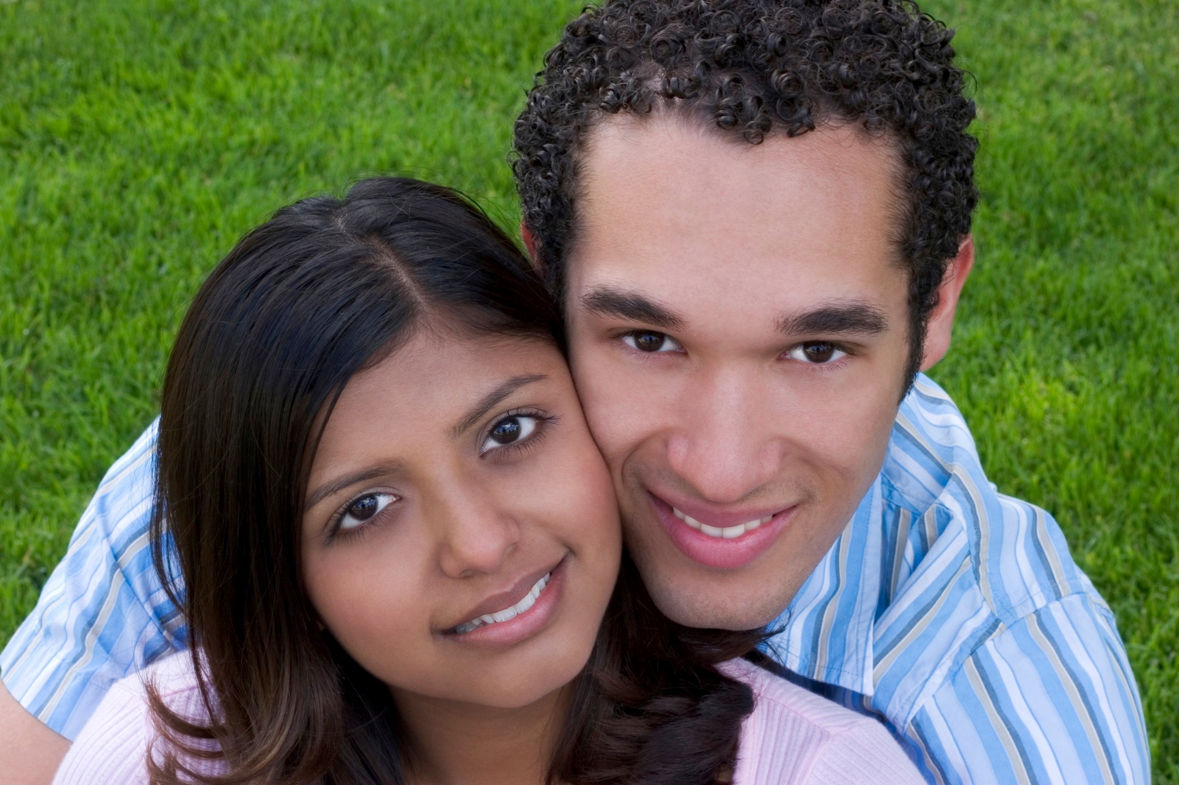

Slide 3


Slide 4
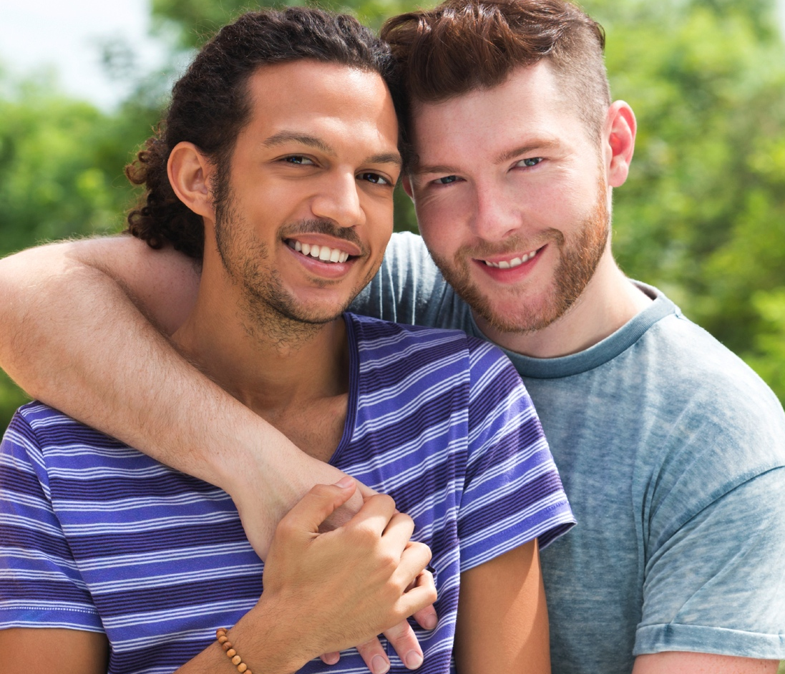

Slide 5
