Slide 1

Puberty and Reproduction
5th Grade Lesson from Rights, Respect, Responsibility: A K-12 Sexuality Education Curriculum

Slide 2
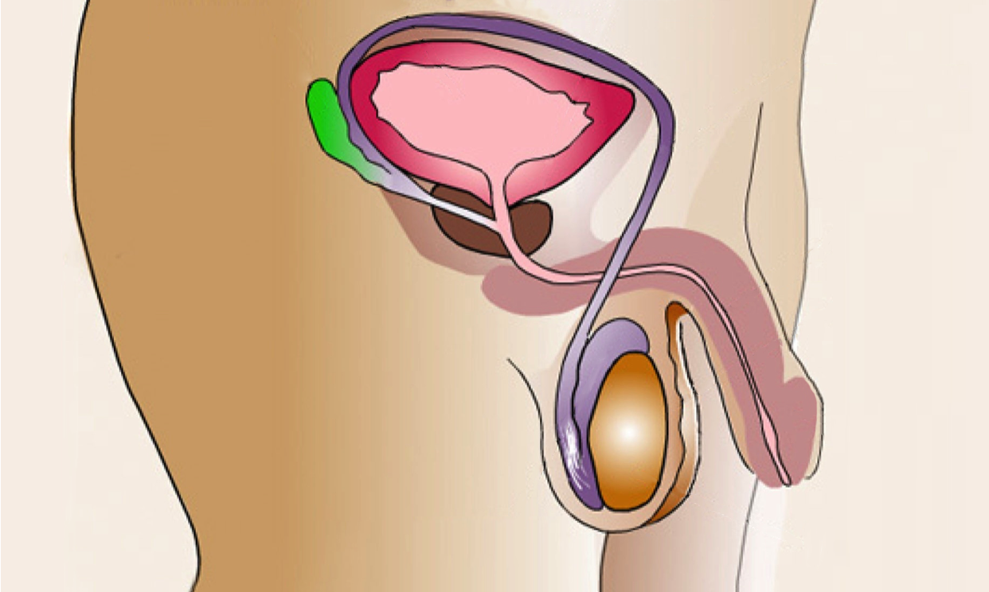
Male Anatomy

Slide 3
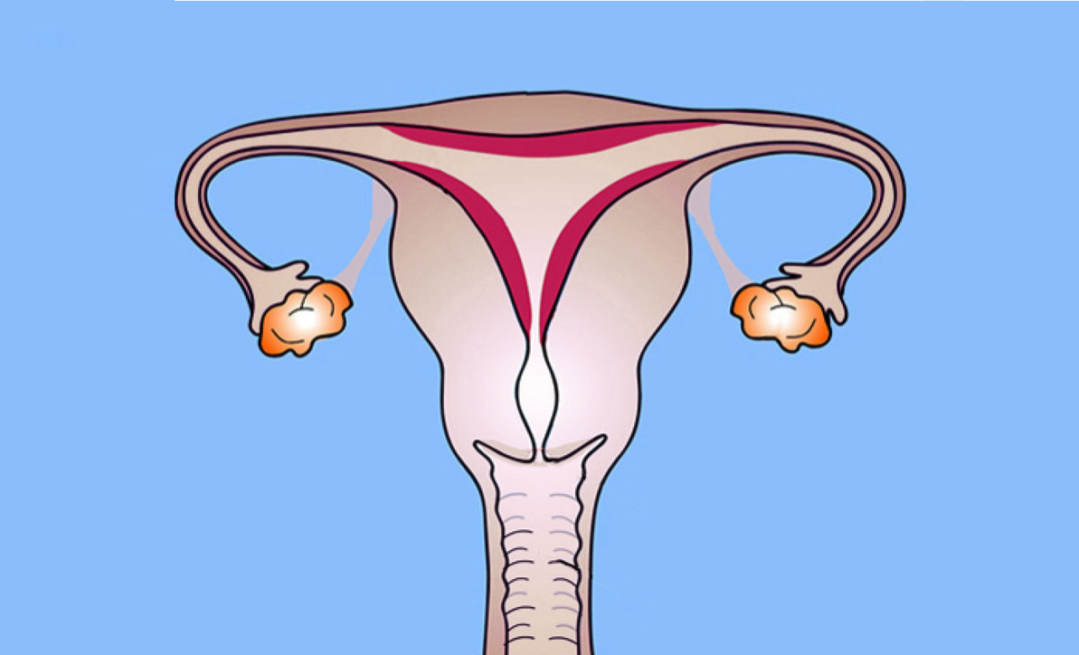
Female Anatomy

Slide 4
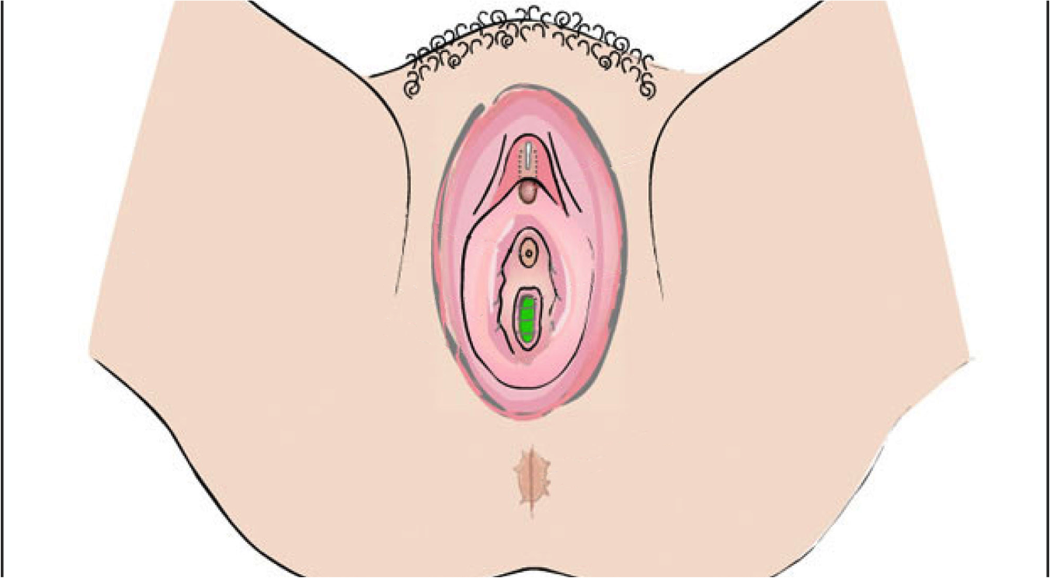
External Female Anatomy

Slide 5
Reproductive Anatomy

