Slide 1

Talking by Texting
8th Grade Lesson – Talking Without Speaking: Texting in Relationships from Rights, Respect, Responsibility: A K-12 Sexuality Education Curriculum

Slide 2
You’re Person One.
What do you think Person Two is saying to you?
Person One: “Liked hanging with you yesterday”
Person Two: “Thx”
Person One: “Hey, I was just thinking about you!”
Person Two: “KK”
Person One: “Thanks for the present. See you tmw!”
Person Two: “???”

Slide 3
You’re Person One.
What do you think Person Two is saying to you?
Person One: “You’re kinda awesome”
Person Two:
Person One: “You haven’t texted me, wth???”
Person Two:

Slide 4



Slide 5
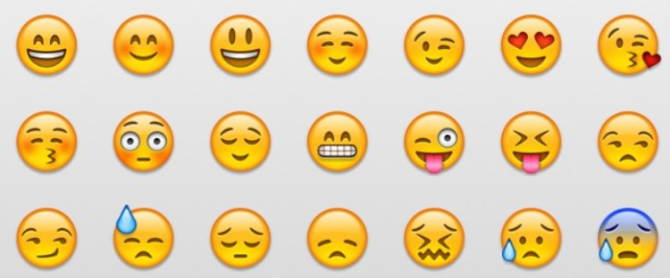
Emojis help…

Slide 6




…but even emojis are limited
Person One: “Wanna hang out?”
Person Two:
  vs. vs. vs.

